Slide 1

Understanding Features

Slide 2
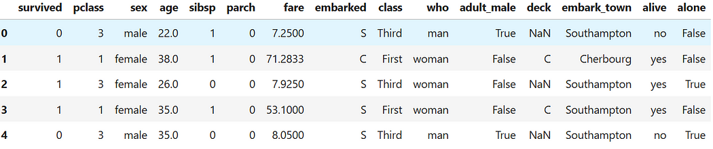
Data Features…..
‘titanic’ dataset in seaborn

Slide 3
Learning Objectives
By the end of this session, you will be able to:
Define categorical, discrete, and continuous features.
Understand the differences and significance of each type.
Explore examples with real-world datasets.
Use Python (Pandas, NumPy, Matplotlib, Seaborn) for data exploration.

Slide 4
Types of Features
1. Categorical Features: Represent labels or categories (e.g., gender, country).
1
2. Discrete Features: Represent countable values (e.g., number of children).
2
3. Continuous Features: Represent measurable values (e.g., height, salary).
3

Slide 5
Categorical Features
Definition: Features that represent categories or groups.
Examples:
- Gender: Male, Female
- Car Type: Sedan, SUV, Truck
- Payment Method: Credit Card, Cash, Digital Wallet

Slide 6
Data Features…..
Which of these are Categorical features?

Slide 7
Types of Categorical Features
1. Nominal: No specific order (e.g., colors: Red, Blue, Green).
2. Ordinal: Has an inherent order (e.g., education levels: High School, Bachelor’s, Master’s).

Slide 8
Discrete Features
Definition: Numerical features that take countable, finite values.
Examples:
- Number of children in a family
- Number of products purchased
- Number of login attempts

Slide 9
Data Features…..
Which of these are Discrete features?

Slide 10
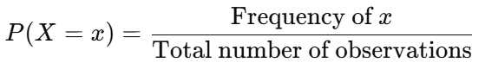
Mathematical Properties of Discrete Features
Countable values with no intermediate values.
Follows probability mass functions (PMF).
Example: Number of calls received per day:

Slide 11
Continuous Features
Definition: Numerical features that can take any value within a range.
Examples:
- Height and weight
- Temperature and pressure
- Income and expenses

Slide 12
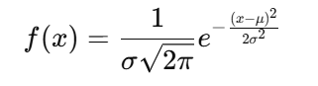
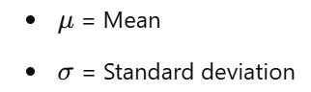
Mathematical Properties of Continuous Features
Can take infinite values within a range.
Follows probability density functions (PDF).
Example: Height of individuals:

Slide 13
Python Implementation
‘titanic’ dataset in seaborn

Slide 14
Multiple Choice Questions (MCQs)
Q1: Which feature type is used to represent customer feedback: “Satisfied,” “Neutral,” “Dissatisfied”?
A) Categorical
B) Discrete
C) Continuous
D) Ordinal
Q2: The number of books a person owns is an example of which feature type?
A) Categorical
B) Discrete
C) Continuous
D) Ordinal

Slide 15
Multiple Choice Questions (MCQs)
Q1: Which feature type is used to represent customer feedback: “Satisfied,” “Neutral,” “Dissatisfied”?
A) Categorical ✅
B) Discrete
C) Continuous
D) Ordinal
Q2: The number of books a person owns is an example of which feature type?
A) Categorical
B) Discrete ✅
C) Continuous
D) Ordinal

Slide 16
Fill in the blanks
1. ______ features represent categories or groups.
2. A ______ feature can take any value within a range.
3. The count of items purchased is an example of a ______ feature.

Slide 17
Fill in the blanks
1. ______ features represent categories or groups. (Answer: Categorical)
2. A ______ feature can take any value within a range. (Answer: Continuous)
3. The count of items purchased is an example of a ______ feature. (Answer: Discrete)

Slide 18
Session Summary
In this session, we have discussed about:
Define categorical, discrete, and continuous features.
Understand the differences and significance of each type.
Explore examples with real-world datasets.
Use Python (Pandas, NumPy, Matplotlib, Seaborn) for data exploration.

Slide 19
Reference Links
Python notebook
How to Create Stunning Data Visualizations in Python: Top 10 Techniques to Learn
Mastering Credit Risk Analysis: A Step-by-Step Guide to Descriptive Statistics in Python
How Much Statistics Do You Really Need for Data Science?
Phases of data science and analytics.

Slide 20

THANK YOU
For any Query:
Website- www.onlinecu.in
Helpline no.: 1800 121 388 800

